Slide 1
Optimization and Control of
Gasification Process
Priyanka Kumari, Veer Bahadur Singh
Supervised by:
Dr. Rishi Raj

Slide 2
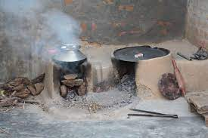
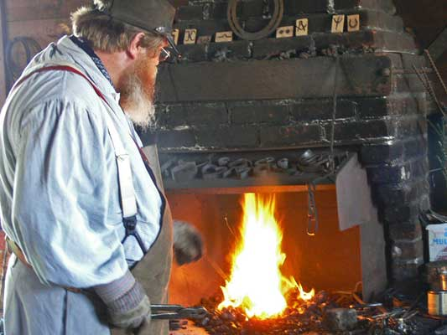
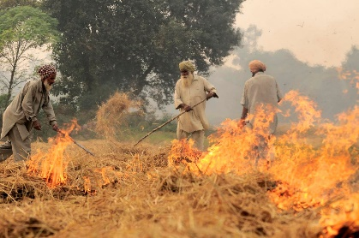
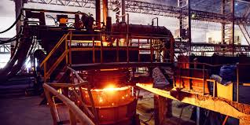
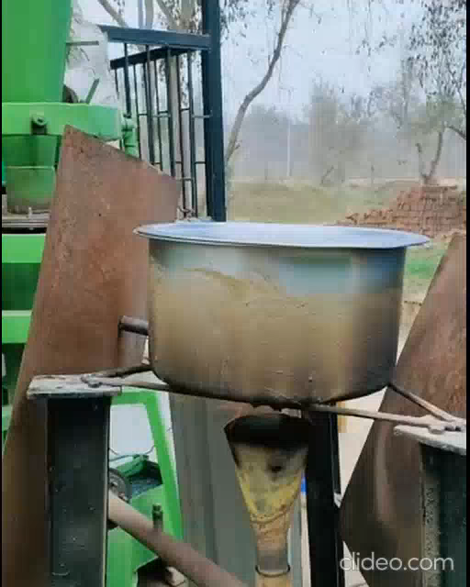
Background and Motivation
High price of LPG and other fuel
In rural area direct combustion of biomass preferable over LPG
Difficulty in controlling flame of a brick stove.
Blacksmith: directly burning coal.
Highly burning of crops remain/agro-residue in Haryana and Delhi and causes harmful emissions.
Industrial heating
Brick Kilns
Pulp & paper Industries
Small-scale textiles and glass manufacturers
Used by Bhakti Vedanta club for Prasadam cooking.
Source: Internet

Slide 3
Literature review with summary and research gaps
Gasifier Efficiency (5-10 kW):
Air staging for improved efficiency (Galindo et al., 2014).
Premixing air with producer gas to reduce tar (Jaojaruek et al., 2011).
Need for capacity control and optimization
Stove Comparison:​
Compare fuel usage and indoor air pollution (C. V. Raiyan et al., 1993).​
Burner Fabrication and Optimization:​​
Burners are pivotal components in gasifier systems, ensuring optimal flame quality.​​
Initial design methods (B. Sutar et al., 2016) and specific optimization, particularly in secondary air entrainment, to enhance overall system performance.​​
Quantifying Output and Capacity Control:​​​
Methods include gas analyser, flame analysis, and energy conservation.​​​
Literature favours energy conservation for quantifying gasifier output & capacity control due to cost and equipment availability (Anil K. Rajvanshi et al., FAO 2014).​​​
Control:​​​​
Explore gasification control methods.​​​​
Implement machine learning for real-time monitoring (Elmaz et al., 2020; Mutlu et al., 2018).​​​​

Slide 4
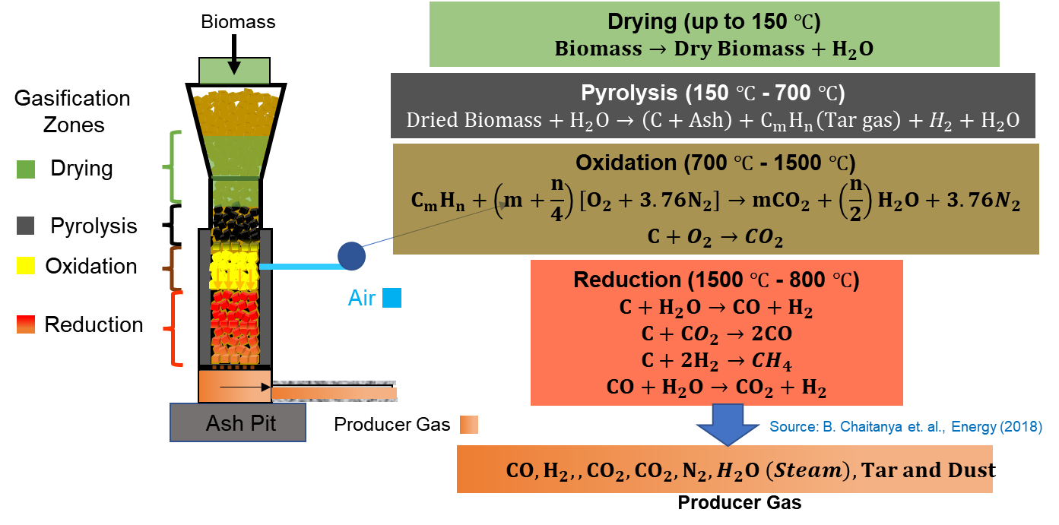
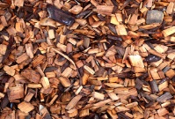
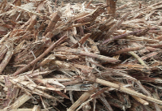
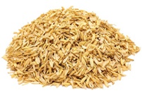
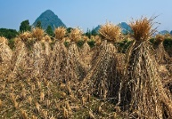
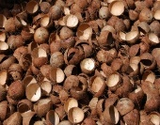
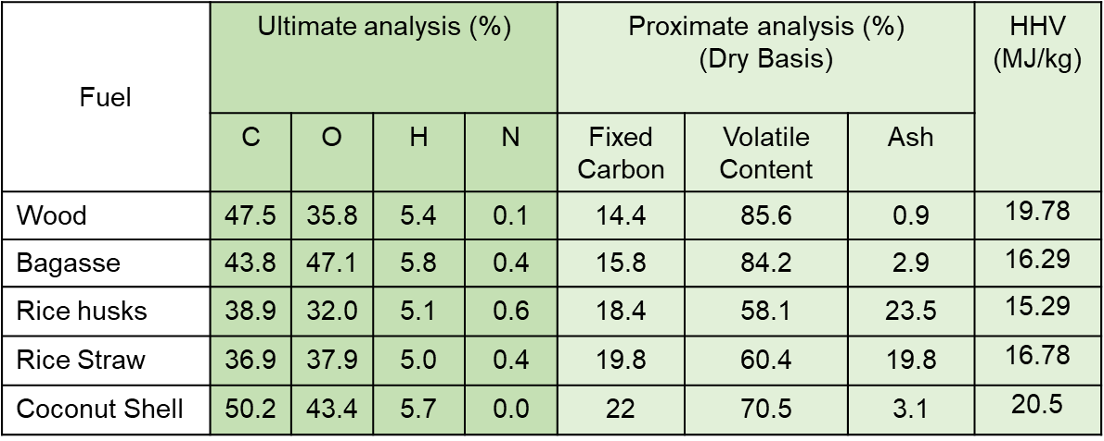
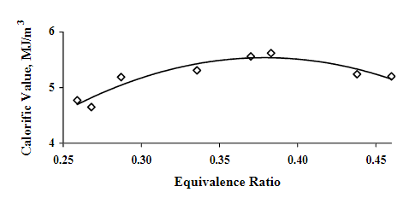
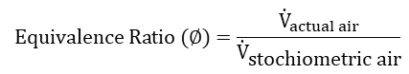
Gasification: Brief Introduction
Producing combustible gas incomplete combustion of biomass​
Based on air supply 3 different types of gasifier are classified​
Updraft, Crossdarft, Downdraft : preferred less tar content
Biomass and its Characterization
Wood Waste
Bagasse
Rice Husk
Rice Straw
Coconut Shell
Air supply
0.38
Source: Kirubakaran et al., Renewable and Sustainable Energy Reviews (2009)
$$Equivalence Ratio (∅)=\frac{{\dot{V}}_{actual air}}{{\dot{V}}_{\text{stochiometric} \text{air}}}$$
Source: Zanial et al., Biomass and Bioenergy (2002)

Slide 5
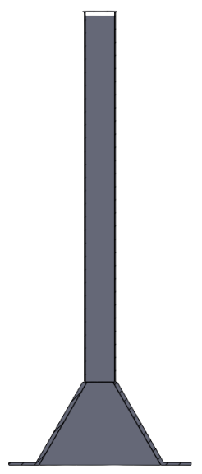
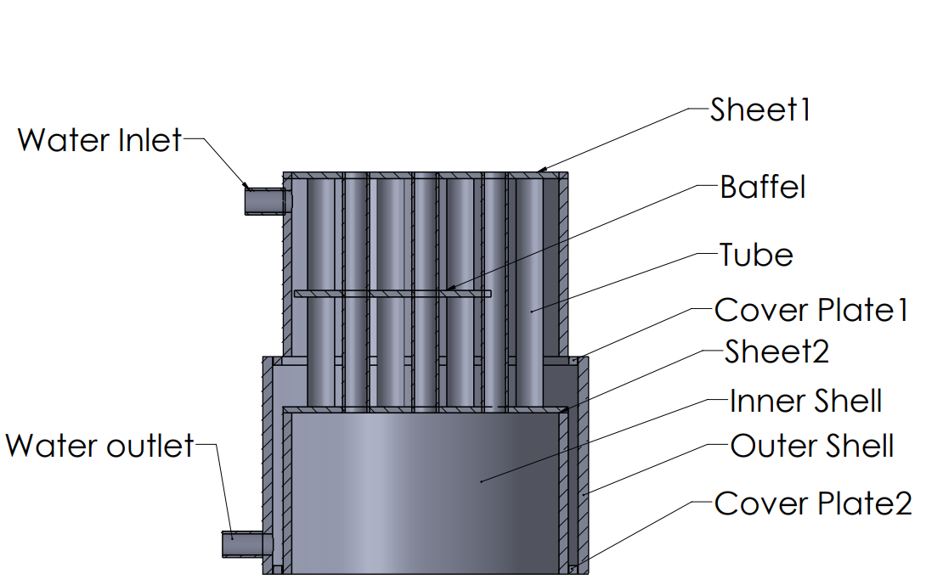
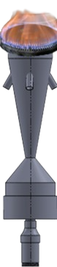

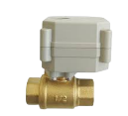

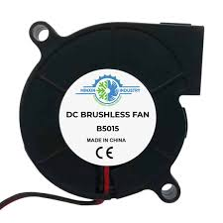

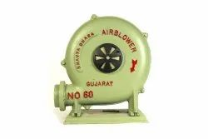



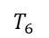
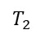
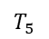
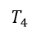
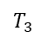
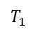
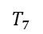
Problem statements and Solution Approach
Optimize and control of the gasification process.
Experiments on Gasifier and identify operation range (Air)
Producer Gas recirculation in combustion zone
Optimize the amount of producer gas and air for best operation
Check for the suitable control algorithms for such problems
Heat Exchanger with chimney
Milestone
Calibration and installation of sensors & actuators.
Design, modification, fabrication and installation of burner.
Design and fabrication and installation of heat exchanger.
Biomass
Proportional valve
Thermocouples
Producer Gas Recirculation
(PGR)
$$T_{1}$$
Hot Air Blower
$$T_{2}$$
Producer
Gas
Burner
$$T_{3}$$
$$T_{4}$$
$$T_{5}$$
$$T_{6}$$
$$T_{7}$$
Hot wire anemometer
Ash Pit
Hot Producer Gas

Slide 6
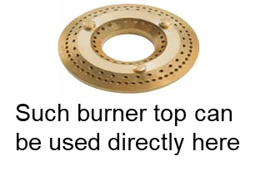
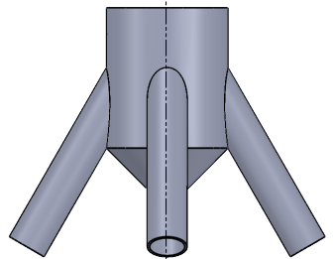
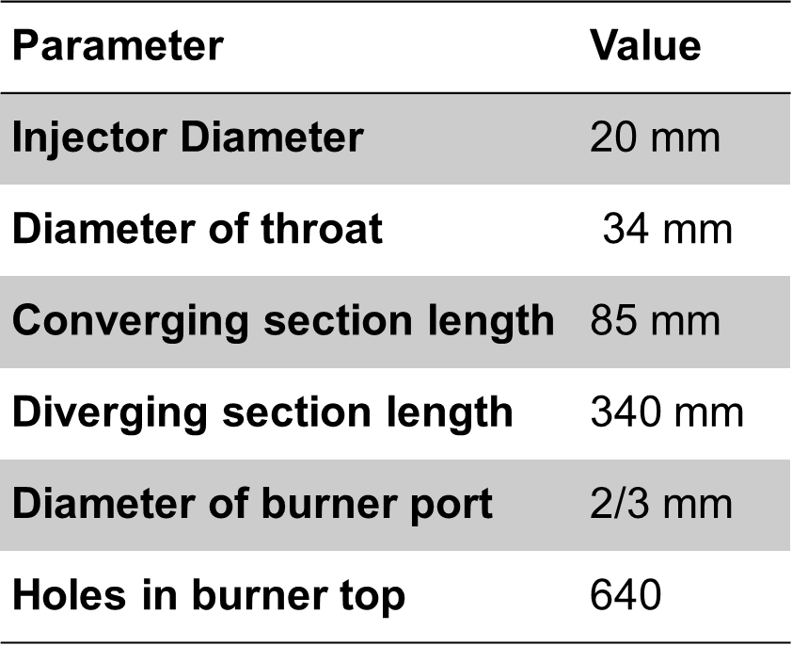
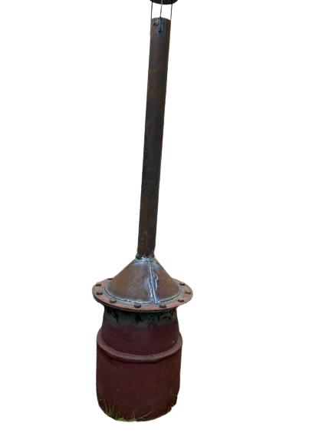
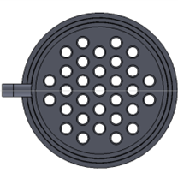
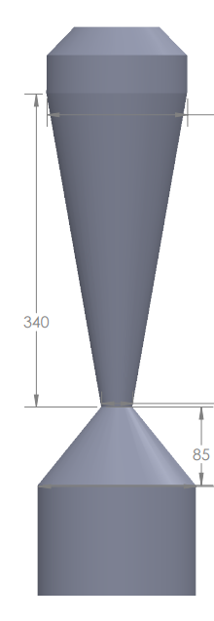
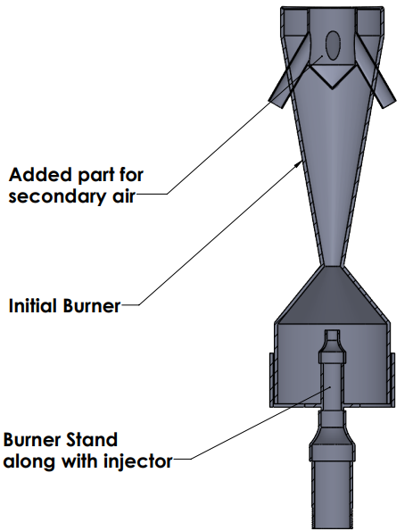
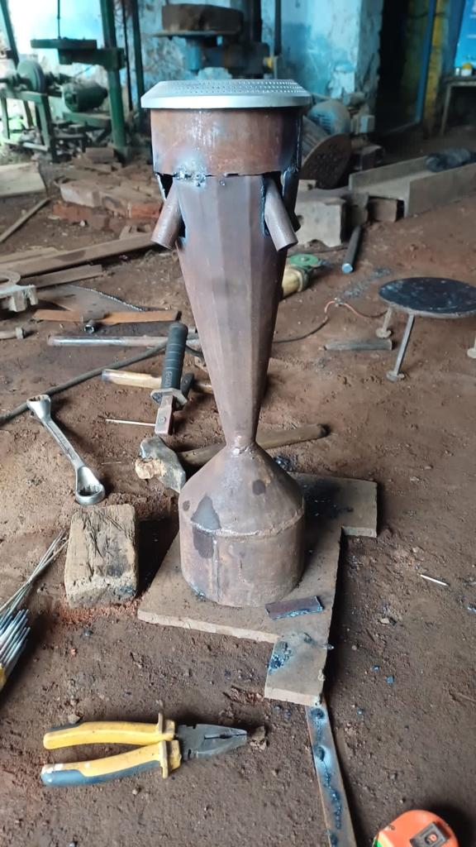
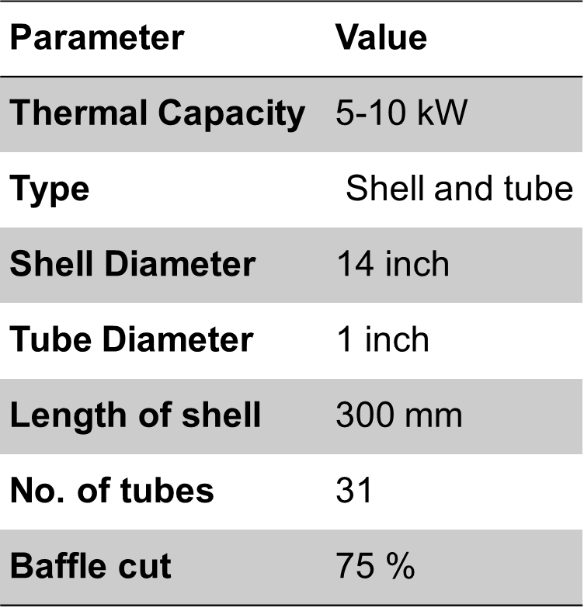
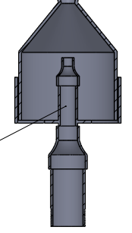

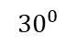
Equipment's required
K-type thermocouple => suitable for there temperature range.
Hot wire anemometer => measures the air flow velocity,
Arduino => controls proportional valve,
Proportional valve => controls air flow rate,
Cooling tower => use for the hot water coming out of heat exchanger,
Flow meter => measure water flow rate
Designs and fabrications
Producer Gas Burner
Heat exchanger
½ inch pipe
1½ inch pipe
Mass Flow Rate of Flue Gas
Flame Temperature of Flue Gas
Heat Transfer Area required
Sizing of the Heat Exchanger: Red-Bag software
Top view
Chimney
$${30}^{0}$$
Heat exchanger
Source: Sutar et. al., Energy (2016)
Source : Anil K. Rajvanshi et al., FAO 2014

Slide 7
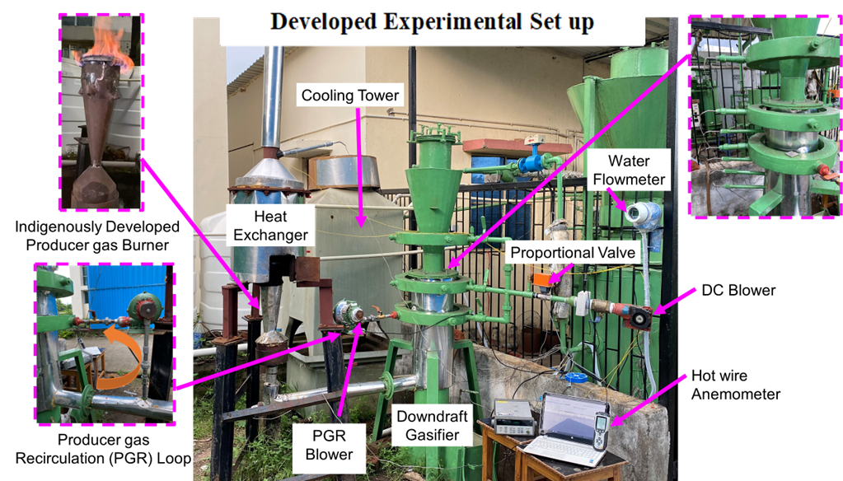
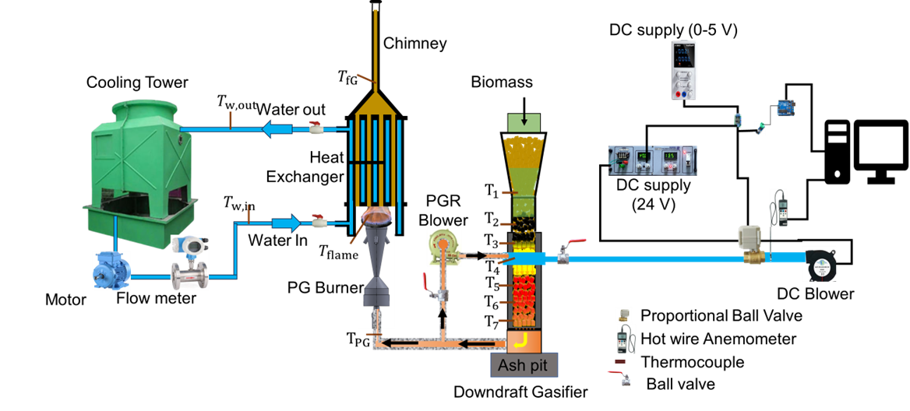
Physical Set-up
Schematic of Set-up
Arduino control system

Slide 8
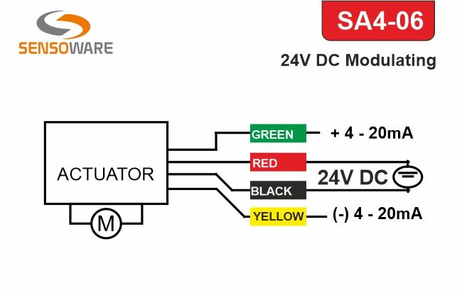
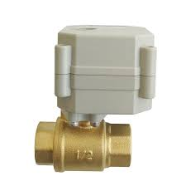
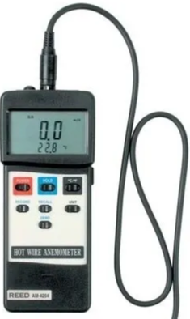
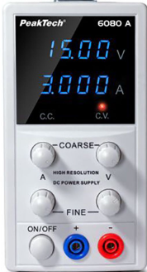



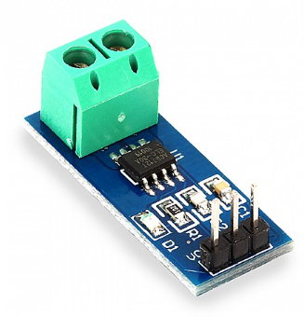
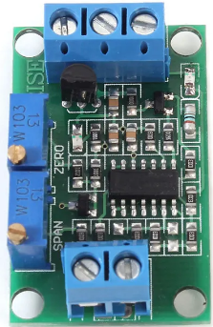
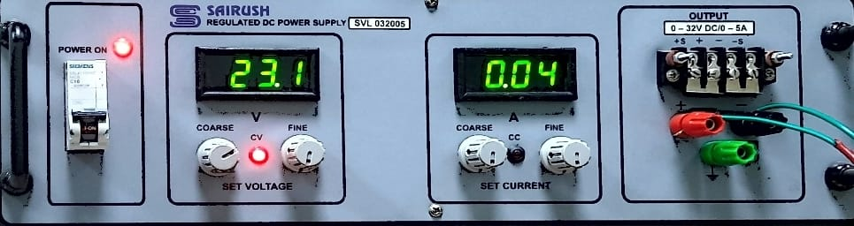
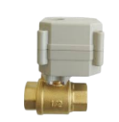

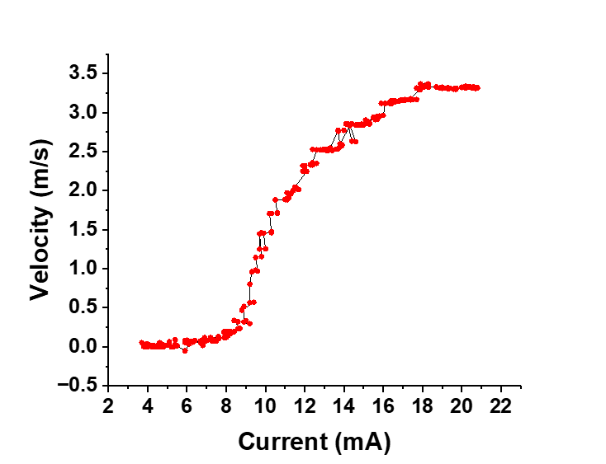


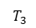








Testing of proportional valve with empty gasifier
We are using this to control air flow rate.
Percentage of opening of this valve depends on provided input current.
Air Blower
Proportional Ball Valve
Hot wire Anemometer
Source: Sensoware
Thermocouple
Arduino control system
Ball valve
Empty Gasifier
$$T_{1}$$
V_{max} $≈$ 3 m/s
$$T_{2}$$
$$T_{3}$$
Proportional Ball Valve
$$T_{4}$$
$$T_{5}$$
$$T_{6}$$
$$T_{7}$$
Ash Pit
$$T_{PG}$$

Slide 9



Preliminarily experiment
Amount of pellet used | 5.5 kg | Biomass consumption rate | 2.5 kg/hr
Time of experiment | 2.25 hr | Water flow rate | 10 LPM
Plot of thermocouples
Plot of Tin and Tout of HEx
0.5hr
AIR
Δ T _{avg}$≈$ 3.6 ^{O}C
Observation – No. of holes on the burner top is not enough

Slide 10





Calculation for no. of holes
T _{avg} = $\frac{(120+30)}{2}$ = 75 ^{O}C = 348K
Gas Mixture
${\dot{m}}_{biomass}$ = 2.23kg/h
${\dot{m}}_{air}$= ρAV = 0.91 kg/h
${\dot{m}}_{air}$/kg biomass $=$0.41 kg
${\dot{m}}_{sto. air}$ = 4.6 kg air/kg biomass
Source : Anil K. Rajvanshi et al., FAO 2014
Equivalence ratio($ε$) $≈$ 0.1
From mass balance
${\dot{ m}}_{air}+{\dot{m}}_{biomass}$ = ${\dot{m}}_{PG}$
${\dot{m}}_{PG}≈$ $3.14\left(\frac{kg}{hr}\right)$
(75 ^{O}C)
We are calculating density by weightage average
Burner
Ρ = 1.164kg/𝑚^3 | d = 52.48mm | V = 0.1m/s
Gases | Density (kg/m3)
CO | 0.9806
CO₂ | 1.5409
H₂ | 0.07
N₂ | 0.9806
CH₄ | 0.5603
O₂ | 1.1065
PG
Air
(120 ^{O}C)
(30 ^{O}C)
Assuming ${\dot{m}}_{air}$ $≈60\% {\dot{m}}_{PG}$
ρ = 0.9886 kg/m3
Source – peace software
After air mixing total amount => (1+0.6)${\dot{m}}_{PG}$ $≈$ 5$\left(\frac{kg}{hr}\right)$
Let the total no. of holes = N
Total area A = (N x (πr²)), where D = 2mm
Flow Velocity of each hole V=70 cm/s
${\dot{m}}_{mix}$ = ρAV => N = 640
Heat capacity Q _{avg} = 2.58 kW
(source: Sutar et. al. Energy (2016))
(Δ T$\text{avg}≈$ 3.6^{O}C)

Slide 11



Producer gas recirculation(PGR) analysis
Without PGR
With PGR
0.5hr
1.7hr
Δ T _{avg}$≈$ 4.5 ^{O}C
Δ T _{avg}$≈$ 5.4 ^{O}C

Slide 12

Parametric comparison of the experiments
Parameters | Without PGR | With PGR
Amount of pellet used | 5kg | 5.5kg
Air flow velocity | 0.1 m/s | 0.13m/s
Time of experiment | 2 hr | 3hr
Water flow rate | 10 LPM | 10 LPM
Biomass consumption rate | 2.5 Kg/hr | 1.8 kg/hr
Equivalence ratio ($ε$) | 0.1 | 0.14
Δ T$\text{avg}$ | 4.5^{O}C | 5.4^{O}C
Q _{avg} | 3.1 kW | 3.7kW
Calorific value of pellets (Source: Kirubakaran et al., Renewable and Sustainable Energy Reviews (2009)) | 18 MJ/kg | 18MJ/kg
Thermal Efficiency of System | 25% | 41%

Slide 13



Conclusion and Future target
Conclusion
Future target
Improved Flame Quality:
Secondary air entrainment in the burner.
Increased top burner holes.
More experiments with PGR.
Experiments with multi air – staging.
Experiments with different type of biomass.
Fluctuations of anemometer need to be rectify by alternate method.
Optimization and control of system.
Old Burner
New Burner
Extended Operation:
Char incorporation at gasifier bottom.
Producer gas recirculation in combustion zone.
Temperature Control:
PGR operation brought early zone temperatures in the range of feasible gasification.
Performance Enhancements (PGR):
Improved thermal efficiency.
Heightened flame stability.

Slide 14
Work Plan
Time span Activity | 7th Semester |  |  | 2020 |  |  | 8th Semester |  |  | 2022
 | Pre mid-sem |  |  | Post mid-sem |  |  | Pre mid-sem |  |  | Post mid-sem
Literature review
CAD Modeling and Fabrication
Proportional Valve testing and Installation
Completion of Experimental Set-Up
Experiments and parametric analysis
CFD analysis of burner and heat exchanger
Control and optimization via ML
 | Proposed
 | Completed

Slide 15
Acknowledgment
We would like to express our sincere gratitude and appreciation to the following individuals for their invaluable support, guidance, and contributions:
1. Supervisor/Advisor: Dr. Rishi Raj
2. PhD Scholar: Sunil Mehra
3. Resources, infrastructure, and access to research materials: IIT Patna & TFTL
We are truly indebted to each of you for your contributions, encouragement, and belief in the success of this project.
Thank you all.
References
K. Jaojaruek et. al. Bioresource Technology (2011)
Ana L. Galindo, et. al. Biomass and Bioenergy (2014)
Kailasnath B. Sutar et. al. Energy (2016): Burner
Elmaz et. al. Fuel (2020): ML
Mutlu et. al. Enegr (2018): ML
C. V. Raiyan et. al. Atmospheric Environmental (1993): Cooking stove smoke.
V. Kirubakarana et al. Renewable and Sustainable Energy Reviews (2009)
BIOMASS GASIFICATION By Anil K. Rajvanshi
W.1 H2 4U Pty Lt https://h24u.com/types-of-gasifiers/
W.2 Red Bag
www.red-bag.com
W.3 Peace Software https://www.peacesoftware.de/
W.4 Circuital Globe
CircuitalGlobe.com

Slide 16
Thank you

Slide 17
Backup slides

Slide 18

Hot wire anemometer
Hot Wire Anemometer works When an electrically heated wire is placed in a flowing gas stream, heat is transferred from the wire to the gas and hence the temperature of the wire reduces, and due to this, the resistance of the wire also changes. This change in resistance of the wire becomes a measure of flow rate.
Thermal (or “hot wire”) anemometers use the principle that the amount of heat removed from a heated temperature sensor by a flowing fluid can be related to that fluid's velocity. These sensors typically use a second, unheated temperature sensor to compensate for variations in the air temperature.
There are two methods of measuring flow rate using a anemometer bridge combination namely:
Constant current method
Constant temperature method

Slide 19









Assuming the typical Composition of Producer gas
Raw Producer gas (PG)
Components | Percentage (vol.%) | Lower Calorific Value $\left({MJ}/{{Nm}^{3}}\right)$
$$H_{2}$$ | 18 | $≈$10
$$CO$$ | 20 | $≈$12
$$CH_{4}$$ | 2 | $≈$36
$$CO_{2}$$ | 20 | -
$$N_{2}$$ | 40 | -
$$LCV of PG =\left(0.18×10 \right)+\left(0.12×12\right)+\left(0.02×36\right)=4.92≈5 {MJ}/{N m^{3}}$$
As volume fraction for ideal gas can be used as mole fraction
Combustion Reaction for Producer gas:
Producer gas (PG)
Air
$$0.18 H_{2}+0.2 {CO}_{2}+0.4 N_{2}+0.2 CO +0.02 {CH}_{4} +Z \left(O_{2}+3.76N_{2}\right)→X {CO}_{2}+Y H_{2}O+W N_{2}$$
Balancing H : $\left(0.18×2\right)+\left(0.02×4\right)=2X$
$$X=0.22$$
Balancing C : $0.2+0.2+0.02=Y$
$$Y=0.42$$
Balancing O : $\left(0.2×2\right)+0.2+2Z=2Y+X$
$$Z=0.23$$
Balancing N :$\left(0.4×2\right)+Z\left(2×3.76\right)=2W$
$$W=1.26$$
Hence 1 Kmol of PG needs $\left\{0.23×\left(1+3.76\right)\right\}=1.1$ kmol of air

Slide 20


















Design of Shell & Tube Heat Exchanger
Calculation for Mass Flow Rate of Flue Gas
3. Heat Duty Range of the Heat Exchanger
Flue Gas
$${\dot{m}}_{sto. air}=4.6 {kg air}/{kg biomass}$$
Heat Balance In Heat Exchanger
Burner
$$ε=0.25 (assumed)$$
$$\left\{{\dot{m}}_{fG}×C_{p,fg}×\left(T_{ad, fg}−T_{fg,out}\right)\right\}=\left\{{\dot{m}}_{w}×C_{pw}×\left({∆T}_{w}\right)\right\}……(4)$$
${\dot{m}}_{air}=ε {\dot{m}}_{sto. air}$= $1.14\left(\frac{kg}{hr}\right)$
$${\dot{m}}_{biomass} + {\dot{ m}}_{air} = {\dot{m}}_{PG}$$
$$\left\{\frac{5}{3600}×1.3×\left(1600−200\right)\right\}=\left\{\frac{0.010}{60}×1000×4.2×\left({∆T}_{w}\right)\right\}$$
PG
Air
${\dot{m}}_{PG}≈$ $2.14\left(\frac{kg}{hr}\right)$
Assuming
$$T_{fG,out}≈200 ℃$$
${\dot{m}}_{PG}≈$ $2.14, \left(\frac{kg}{hr}\right)$ PG requires $=\frac{32}{26.3}×2.14=$ 2.6 $\left(\frac{kg}{hr}\right)$ Air
$${∆T}_{w}=3.6 ≈4℃$$
$${∆T}_{LMTD, counter}=\frac{\left(1600−29\right)−\left(200−25\right)}{\ln{\frac{\left(1600−29\right)}{\left(200−25\right)}}}$$
$${∆T}_{LMTD, counter}=636℃$$
Water in
Mass Flow Rate of Flue Gas $≈$ $2.14+2.6=4.74\left(\frac{kg}{hr}\right)$
Assuming
$${\dot{m}}_{w}≈10 LPM$$
$$T_{w, in}≈25 ℃$$
2. Calculation for Flame Temperature of Flue Gas
Water out
Energy Balance In Burner
$$A=\frac{Q}{U F ∆T_{LMTD, counter}}$$
$$T_{w, out}≈29 ℃$$
$$\left({LCV}_{PG} ×{\dot{m}}_{PG}\right)×η_{burner}=\left\{{\dot{m}}_{fG}×C_{p,fg}×\left(T_{ad, fg}−T_{in}\right)\right\}$$
Flue Gas
$$T_{fg}=1592 ℃≈1600℃$$
$Assuming U=15W/{m^{2}−K}$=>$A=0.30 m^{2}$
$${\dot{m}}_{fG}≈5{kg}/{hr}$$
$$T_{fG,in}≈1600 ℃$$
For a gasifier with 1 kg/hr. biomass consumption
For a gasifier with higher capacity for $≈$3 kg/hr. biomass consumption
Source : Anil K. Rajvanshi et al., FAO 2014
$$Heat Transfer Area required≈0.9 m^{2}$$

Slide 21






4. Sizing of the Heat Exchanger
Tubes of three sizes (½ inch, ¾ inch and 1 inch) are tried and length of heat exchanger is calculated
Shell Diameter is taken as $≈$340 mm (provided the shell must accommodate the burner beneath it)
Tube sheet is designed using online website: www.red-bag.com
Schedule 40 (14 inch pipe)
Selected ☑
1 Inch Schedule 40 Pipe
Water in
300 mm
ID = 358 mm
OD = 379 mm
Number of Tubes (N) = 31
Heat Transfer Area = 0.9 $m^{2}$
Cover plate to connect 14 inch and 16 inch pipe
$$d_{o,pipe}=33.4 mm$$
200 mm
Minimum Length of Heat Exchanger
$$=\frac{0.9 }{π d_{o}N}$$
$⇒$276 mm
Water Out
Schedule 40 (16 inch pipe)
Taken length $≈$ 300mm

Slide 22



CAD Model (Full Heat Exchanger with additional Shell)
Baffle
Baffle
Exploded View
Burner Area

